Slide 1
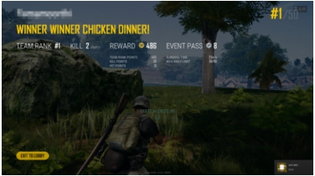
Advertisement
• Prof. Qi Sun from NYU
- VR / AR / perception / RT graphics, http://qisun.me
• Fall 2020 - Spring 2021 (remote is fine) - 2-3 research interns
- 1 postdoc / visiting scholar
• See details on GAMES website / WeChat group
• Send resume to qisun@nyu.edu now!
GAMES101 1 Lingqi Yan, UC Santa Barbara

Slide 2
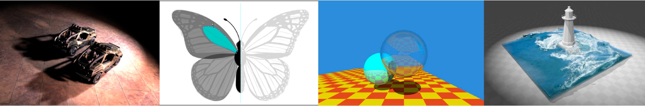
Introduction to Computer Graphics GAMES101, Lingqi Yan, UC Santa Barbara
Lecture 16: Ray Tracing 4
(Monte Carlo Path Tracing)
http://www.cs.ucsb.edu/~lingqi/teaching/games101.html

Slide 3
Announcements
• Regarding the difficulty of the last lecture - Modern Graphics does require it
• We are working on final project ideas
- But again, welcome to come up with your own
• Today’s lecture is easy normal a little bit hard
(Next lectures will be much easier!)
GAMES101 3 Lingqi Yan, UC Santa Barbara

Slide 4
Last Lecture
• Radiometry cont.
• Light transport
- The reflection equation - The rendering equation
• Global illumination
• Probability review
GAMES101
4
Lingqi Yan, UC Santa Barbara

Slide 5
Today
• A Brief Review
• Monte Carlo Integration
• Path Tracing
GAMES101
5
Lingqi Yan, UC Santa Barbara

Slide 6

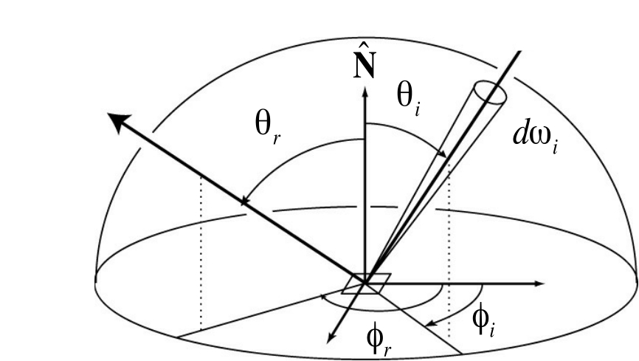
Review - The Rendering Equation
• Describing the light transport
Lo(p, !o) = Le(p, !o) +
⌦+
Z
Li(p, !i)fr(p, !i, !o)(n · !i)d!i
GAMES101 6 Lingqi Yan, UC Santa Barbara

Slide 7
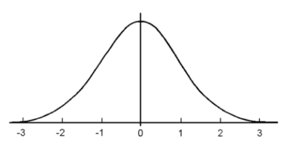
Review - Probabilities
• Continuous Variable and Probability Density Functions
X ⇠ p(x)
• Understanding: randomly pick an X -> more likely to be a
number closer to 0 (in this case)
Z
Conditions on p(x): p(x) 0 and p(x) dx = 1
Z
Expected value of X: E[X] = xp(x) dx
GAMES101 7 Lingqi Yan, UC Santa Barbara

Slide 8
Monte Carlo Integration

Slide 9
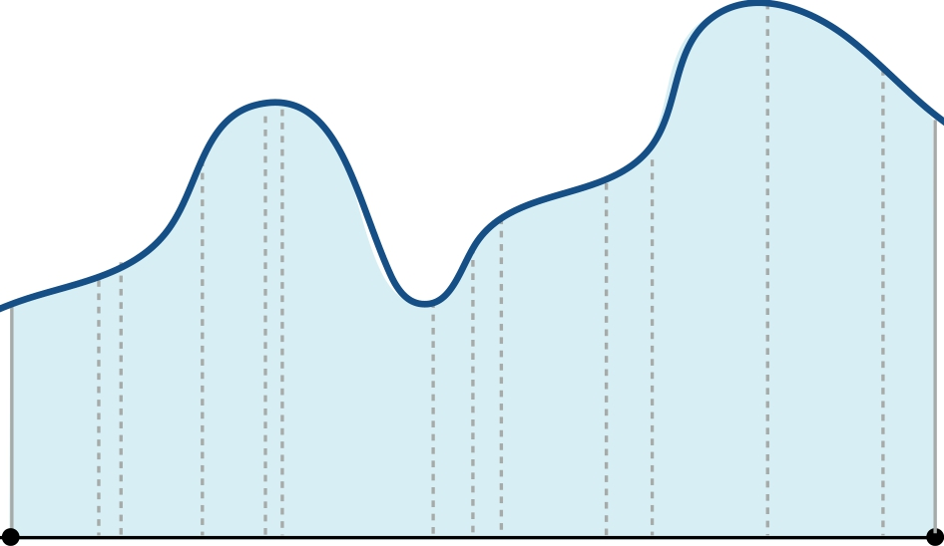
Monte Carlo Integration
Why: we want to solve an integral, but it can be too difficult to solve analytically.
Z
f (x) b f (x)dx
a
a xi b
GAMES101 9 Lingqi Yan, UC Santa Barbara

Slide 10
Monte Carlo Integration
What & How: estimate the integral of a function by averaging random samples of the function’s value.
Z
f (x) b f (x)dx
a
a xi b
GAMES101 10 Lingqi Yan, UC Santa Barbara

Slide 11
Monte Carlo Integration
Let us define the Monte Carlo estimator for the definite integral of given function f (x)
Z
Definite integral b f (x)dx
a
Random variable Xi ⇠ p(x)
N
i=1
1
N
X
f(Xi) p(Xi)
Monte Carlo estimator
FN =
GAMES101 11 Lingqi Yan, UC Santa Barbara

Slide 12
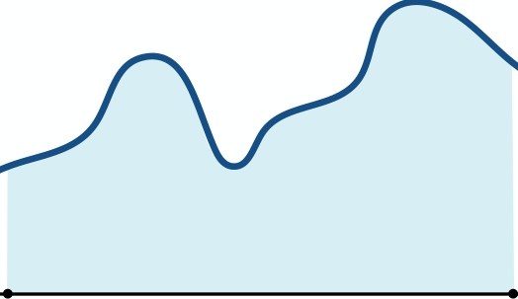
Example: Uniform Monte Carlo Estimator
Z
Uniform random variable f (x) b f (x)dx
a
Xi ⇠ p(x) = C
b
p(x) dx = 1
a
(constant)
Z
a
xi
b
=) Z
b C dx = 1 p(x)
a 1
=) C = b 1 a b a a xi b
GAMES101 12 Lingqi Yan, UC Santa Barbara

Slide 13
Example: Uniform Monte Carlo Estimator
Let us define the Monte Carlo estimator for the definite integral of given function f (x)
Z
Definite integral b f (x)dx
a
Uniform random variable Xi ⇠ p(x) = b 1 a
N
i=1
FN = b
a
X
Basic Monte Carlo estimator
f(Xi)
N
GAMES101 13 Lingqi Yan, UC Santa Barbara

Slide 14
Monte Carlo Integration
Z
N
i=1
1
N
X
f(Xi) p(Xi)
f(x)dx =
Xi ⇠ p(x) f(Xi)
Some notes:
• The more samples, the less variance.
• Sample on x, integrate on x.
GAMES101 14 Lingqi Yan, UC Santa Barbara

Slide 15
Path Tracing

Slide 16
Motivation: Whitted-Style Ray Tracing
Whitted-style ray tracing:
- Always perform specular reflections / refractions - Stop bouncing at diffuse surfaces
Are these simplifications reasonable?
High level: let’s progressively improve upon Whitted-Style Ray Tracing and lead to our path tracing algorithm!
GAMES101 16 Lingqi Yan, UC Santa Barbara

Slide 17
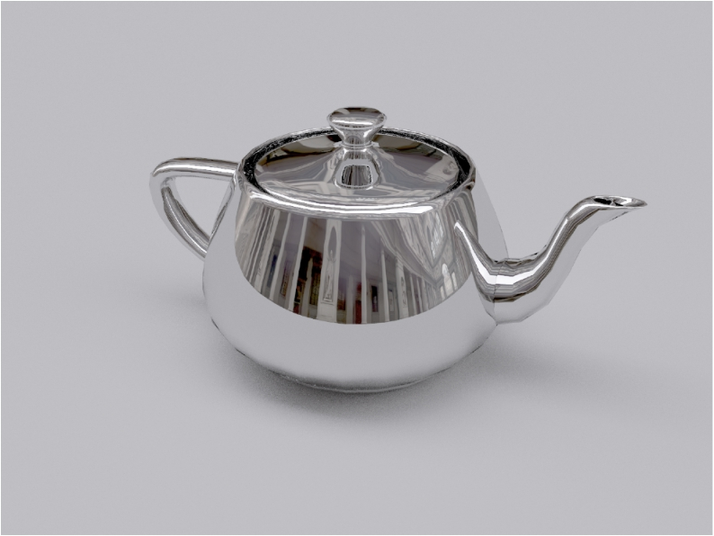
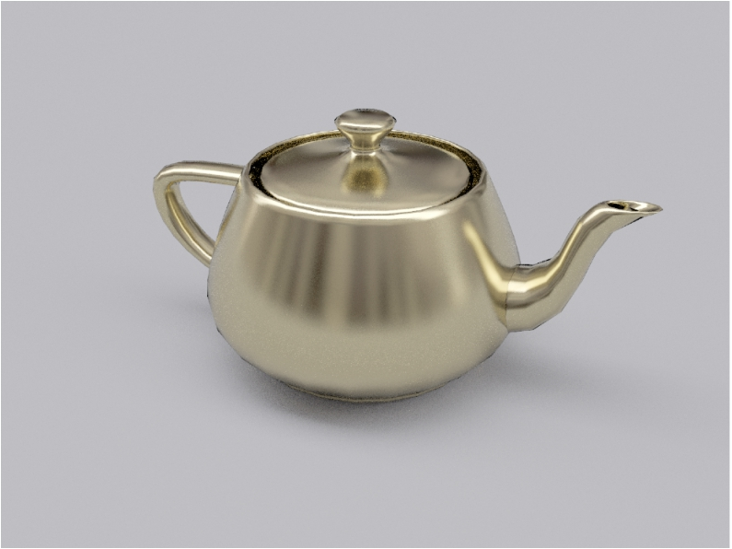
Whitted-Style Ray Tracing: Problem 1
Where should the ray be reflected for glossy materials?
Mirror reflection Glossy reflection
The Utah teapot
GAMES101 17 Lingqi Yan, UC Santa Barbara

Slide 18
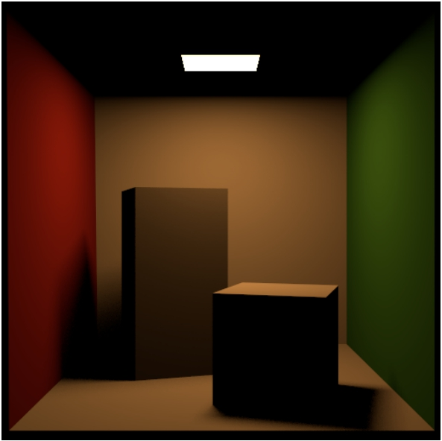
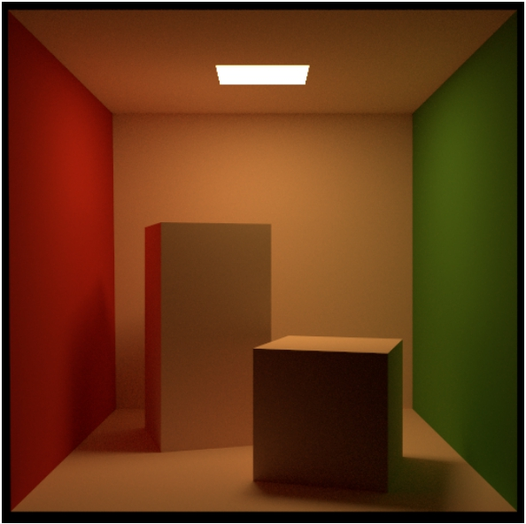
Whitted-Style Ray Tracing: Problem 2
No reflections between diffuse materials?
Path traced:
direct illumination
Path traced:
global illumination
The Cornell box
GAMES101 18 Lingqi Yan, UC Santa Barbara

Slide 19
Whitted-Style Ray Tracing is Wrong
But the rendering equation is correct
Lo(p, !o) = Le(p, !o) +
⌦+
But it involves
- Solving an integral over the hemisphere, and - Recursive execution
How do you solve an integral numerically?
Z
Li(p, !i)fr(p, !i, !o)(n · !i)d!i
GAMES101 19 Lingqi Yan, UC Santa Barbara

Slide 20
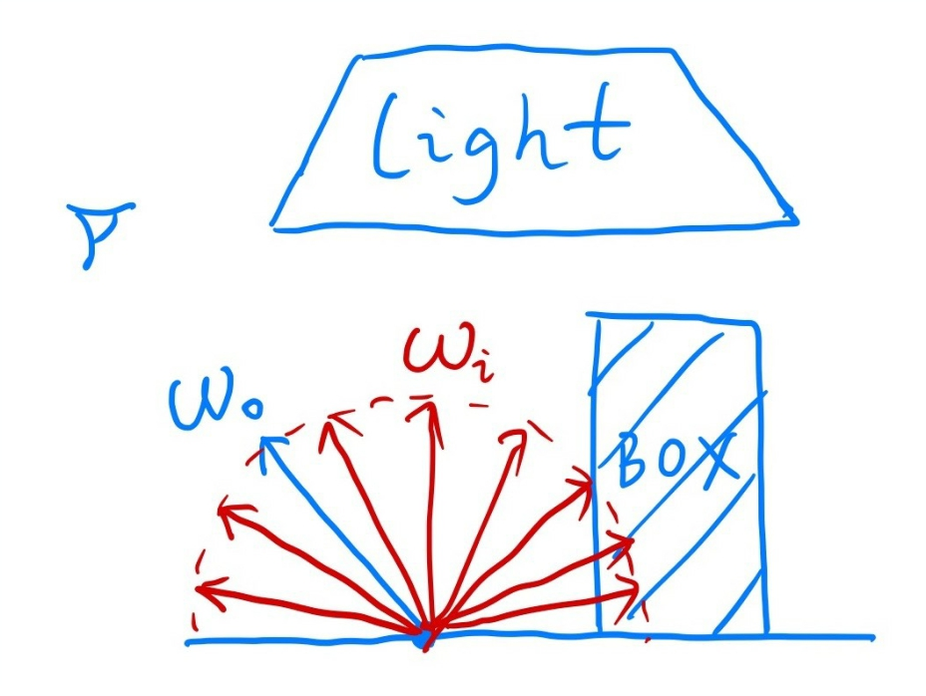
A Simple Monte Carlo Solution
Suppose we want to render one pixel (point) in the following scene for direct illumination only
Note: this is an area light
GAMES101 20 Lingqi Yan, UC Santa Barbara

Slide 21
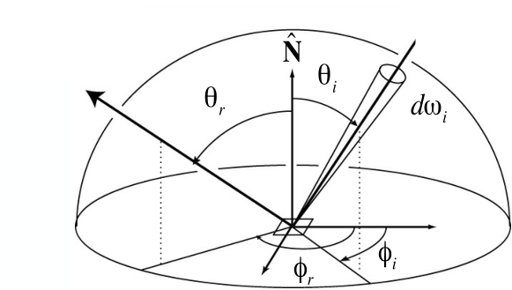
A Simple Monte Carlo Solution
Abuse the concept of Reflection Equation a little bit
Lo(p, !o) =
Z
Li(p, !i)fr(p, !i, !o)(n · !i)d!i
⌦+ (again, we assume all directions are pointing outwards)
Fancy as it is, it’s still just an integration over directions
So, of course we can solve it using Monte Carlo integration!
GAMES101 21 Lingqi Yan, UC Santa Barbara

Slide 22
A Simple Monte Carlo Solution
We want to compute the radiance at p towards the camera
Lo(p, !o) =
⌦+
Z
Li(p, !i)fr(p, !i, !o)(n · !i)d!i
Z
N
k=1
Monte Carlo integration:
b
a
1
N
X
f (Xk) p(Xk)
f (x)dx ⇡
Xk ⇠ p(x)
What’s our “f(x)”? Li(p, !i)fr(p, !i, !o)(n · !i)
What’s our pdf? p(!i) = 1/2⇡
(assume uniformly sampling the hemisphere)
GAMES101 22 Lingqi Yan, UC Santa Barbara

Slide 23
A Simple Monte Carlo Solution
So, in general
Lo(p, !o) =
⌦+
Z
Li(p, !i)fr(p, !i, !o)(n · !i)d!i
N
i=1
1
N
X
⇡
Li(p, !i)fr(p, !i, !o)(n · !i) p(!i)
(note: abuse notation a little bit for i)
What does it mean?
A correct shading algorithm for direct illumination!
GAMES101 23 Lingqi Yan, UC Santa Barbara

Slide 24
A Simple Monte Carlo Solution
N
i=1
1
N
X
Lo(p, !o) ⇡
Li(p, !i)fr(p, !i, !o)(n · !i) p(!i)
shade(p, wo)
Randomly choose N directions wi~pdf Lo = 0.0
For each wi
Trace a ray r(p, wi) If ray r hit the light
Lo += (1 / N) * L_i * f_r * cosine / pdf(wi)
Return Lo
GAMES101 24 Lingqi Yan, UC Santa Barbara

Slide 25
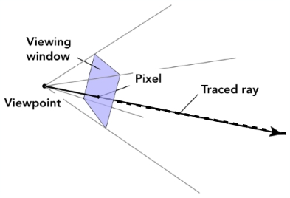
Introducing Global Illumination
One more step forward: what if a ray hits an object?
Q
P
Q also reflects light to P! How much? The dir. illum. at Q!
GAMES101 25 Lingqi Yan, UC Santa Barbara

Slide 26
Introducing Global Illumination
shade(p, wo)
Randomly choose N directions wi~pdf Lo = 0.0
For each wi
Trace a ray r(p, wi) If ray r hit the light
Lo += (1 / N) * L_i * f_r * cosine / pdf(wi)
Else If ray r hit an object at q
Lo += (1 / N) * shade(q, -wi) * f_r * cosine / pdf(wi)
Return Lo
Is it done? No.
GAMES101 26 Lingqi Yan, UC Santa Barbara

Slide 27
Path Tracing
Problem 1: Explosion of #rays as #bounces go up:
#rays = N#bounces 100 -> 10000
10000 -> 1000000
1 -> 100
Key observation: #rays will not explode iff N = ???????
GAMES101 27 Lingqi Yan, UC Santa Barbara

Slide 28
Path Tracing
From now on, we always assume that only 1 ray is traced at each shading point:
shade(p, wo)
Randomly choose ONE direction wi~pdf(w) Trace a ray r(p, wi)
If ray r hit the light
Return L_i * f_r * cosine / pdf(wi)
Else If ray r hit an object at q
Return shade(q, -wi) * f_r * cosine / pdf(wi)
This is path tracing! (FYI, Distributed Ray Tracing if N != 1)
GAMES101 28 Lingqi Yan, UC Santa Barbara

Slide 29

Ray Generation
But this will be noisy!
No problem, just trace more paths through each pixel and average their radiance!
pixel
GAMES101 29 Lingqi Yan, UC Santa Barbara

Slide 30
Ray Generation
Very similar to ray casting in ray tracing
ray_generation(camPos, pixel)
Uniformly choose N sample positions within the pixel
pixel_radiance = 0.0
For each sample in the pixel
Shoot a ray r(camPos, cam_to_sample) If ray r hit the scene at p
pixel_radiance += 1 / N * shade(p, sample_to_cam)
Return pixel_radiance
GAMES101 30 Lingqi Yan, UC Santa Barbara

Slide 31
Path Tracing
Now are we good? Any other problems in shade()?
shade(p, wo)
Randomly choose ONE direction wi~pdf(w)
Trace a ray r(p, wi) If ray r hit the light
Return L_i * f_r * cosine / pdf(wi)
Else If ray r hit an object at q
Return shade(q, -wi) * f_r * cosine / pdf(wi)
Problem 2: The recursive algorithm will never stop!
GAMES101 31 Lingqi Yan, UC Santa Barbara

Slide 32
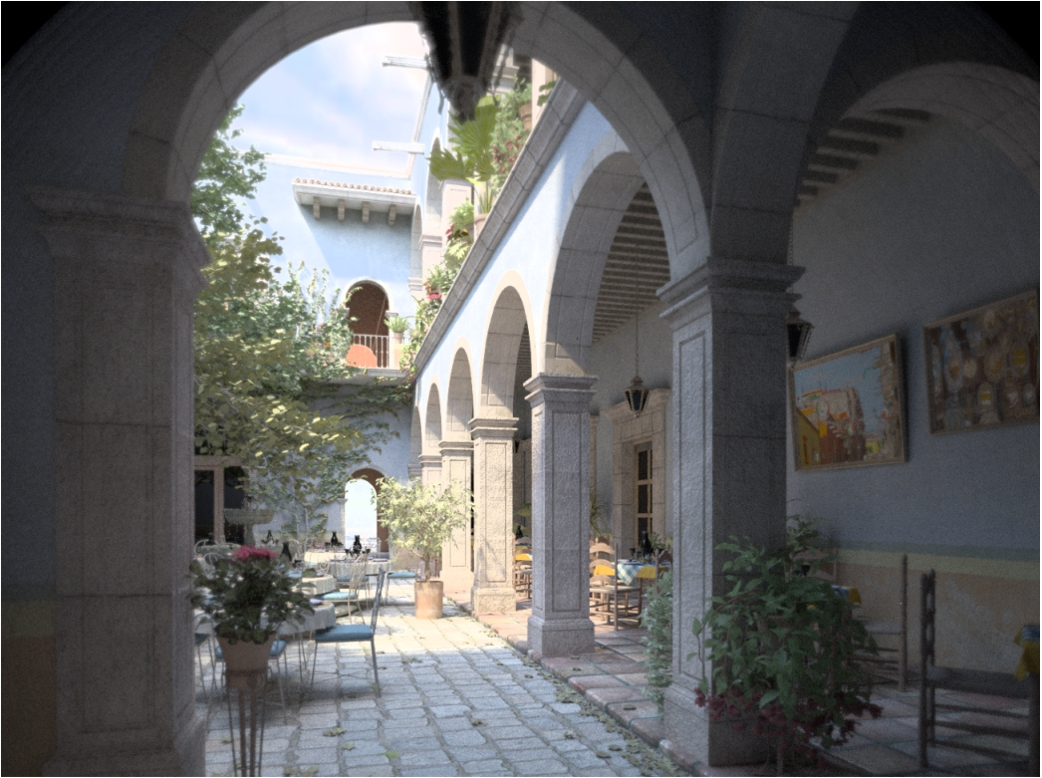
Path Tracing
Dilemma: the light does not stop bouncing indeed! Cutting #bounces == cutting energy!
3 bounces
GAMES101 32 Lingqi Yan, UC Santa Barbara

Slide 33
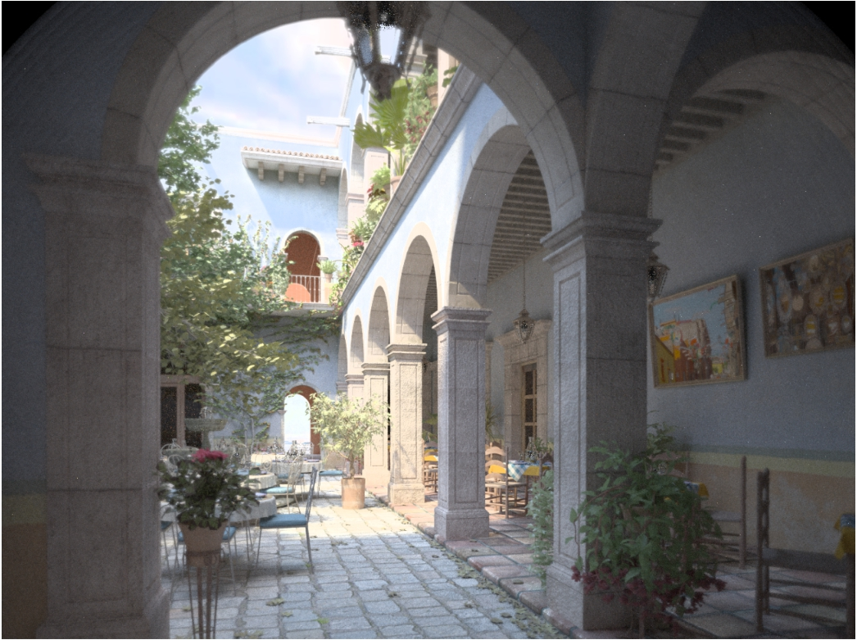
Path Tracing
Dilemma: the light does not stop bouncing indeed! Cutting #bounces == cutting energy!
17 bounces
GAMES101 33 Lingqi Yan, UC Santa Barbara

Slide 34
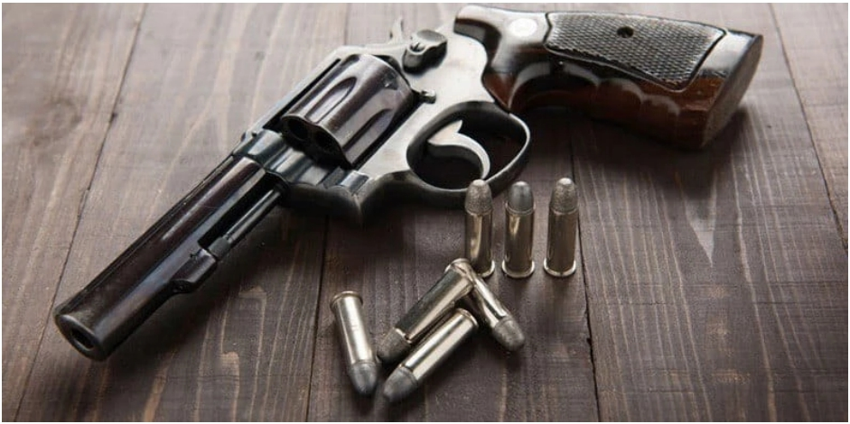
Solution: Russian Roulette (RR)
（俄罗斯轮盘赌）
Russian Roulette is all about probability With probability 0 < P < 1, you are fine With probability 1 - P, otherwise
Example: two bullets, Survival probability P = 4 / 6
GAMES101 34 Lingqi Yan, UC Santa Barbara

Slide 35
Solution: Russian Roulette (RR)
Previously, we always shoot a ray at a shading point and get the shading result Lo
Suppose we manually set a probability P (0 < P < 1)
With probability P, shoot a ray and
return the shading result divided by P: Lo / P
With probability 1-P, don’t shoot a ray and you’ll get 0
In this way, you can still expect to get Lo!: E = P * (Lo / P) + (1 - P) * 0 = Lo
GAMES101 35 Lingqi Yan, UC Santa Barbara

Slide 36
Solution: Russian Roulette (RR)
shade(p, wo)
Manually specify a probability P_RR
Randomly select ksi in a uniform dist. in [0, 1] If (ksi > P_RR) return 0.0;
Randomly choose ONE direction wi~pdf(w) Trace a ray r(p, wi)
If ray r hit the light
Return L_i * f_r * cosine / pdf(wi) / P_RR
Else If ray r hit an object at q
Return shade(q, -wi) * f_r * cosine / pdf(wi) / P_RR
GAMES101 36 Lingqi Yan, UC Santa Barbara

Slide 37
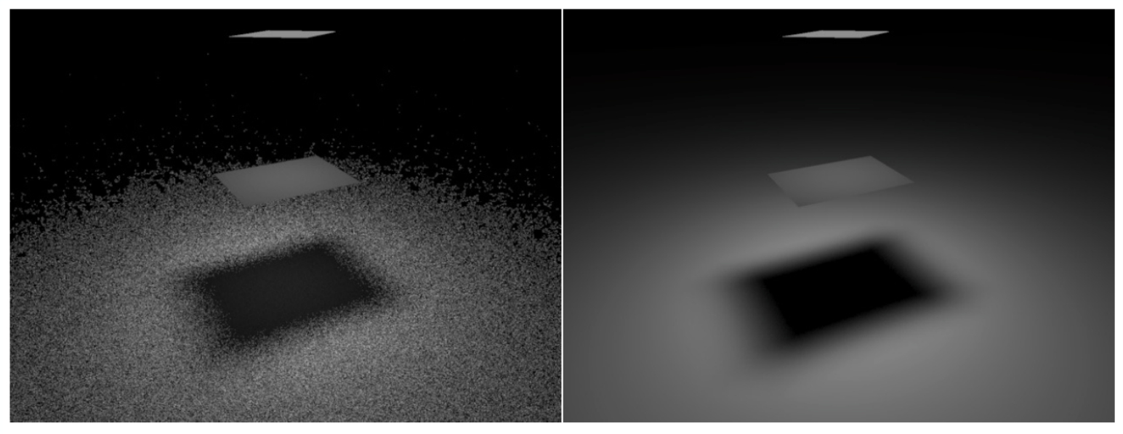
Path Tracing
Now we already have a correct version of path tracing! But it’s not really efficient.
Low SPP (samples per pixel)
noisy results
High SPP
GAMES101 37 Lingqi Yan, UC Santa Barbara

Slide 38
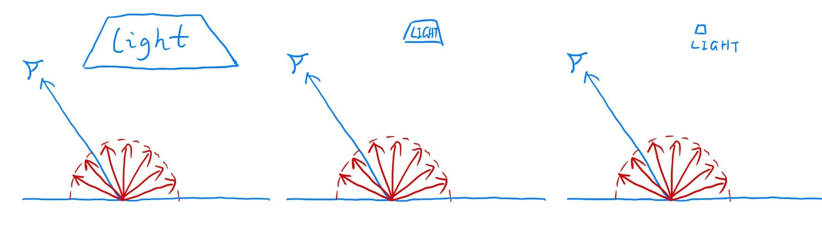
Sampling the Light
Understanding the reason of being inefficient
Every 5 rays, 500 rays, 50000 rays,
there will be 1 ray hitting the light. So a lot of rays are “wasted” if we uniformly sample the hemisphere at the shading point.
GAMES101 38 Lingqi Yan, UC Santa Barbara

Slide 39
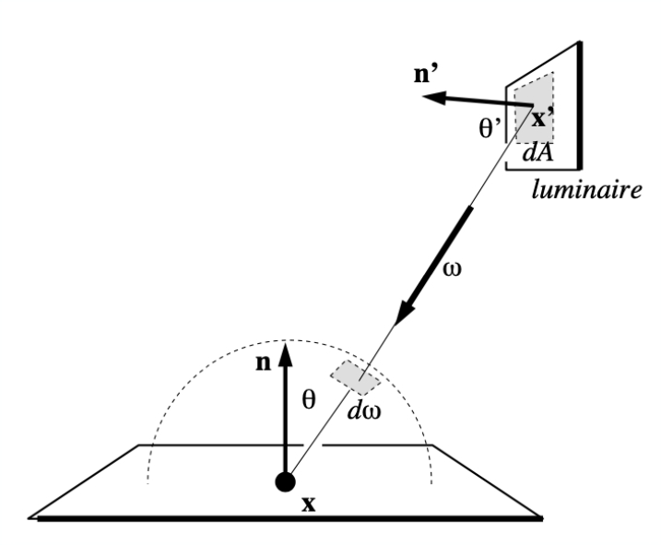
Sampling the Light (pure math)
Monte Carlo methods allows any sampling methods, so we can sample the light (therefore no rays are “wasted”)
Assume uniformly sampling on the light: pdf = 1 / A (because ∫pdf dA = 1)
But the rendering equation integrates on the solid angle: Lo = ∫Li fr cos dω.
Recall Monte Carlo Integration: Sample on x & integrate on x
Since we sample on the light, can we integrate on the light?
GAMES101 39 Lingqi Yan, UC Santa Barbara

Slide 40

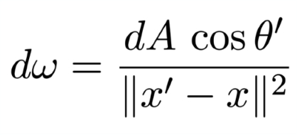
Sampling the Light
Need to make the rendering equation as an integral of dA Need the relationship between dω and dA
Easy! Recall the alternative def. of solid angle: Projected area on the unit sphere
(Note: θ’, not θ)
GAMES101 40 Lingqi Yan, UC Santa Barbara

Slide 41
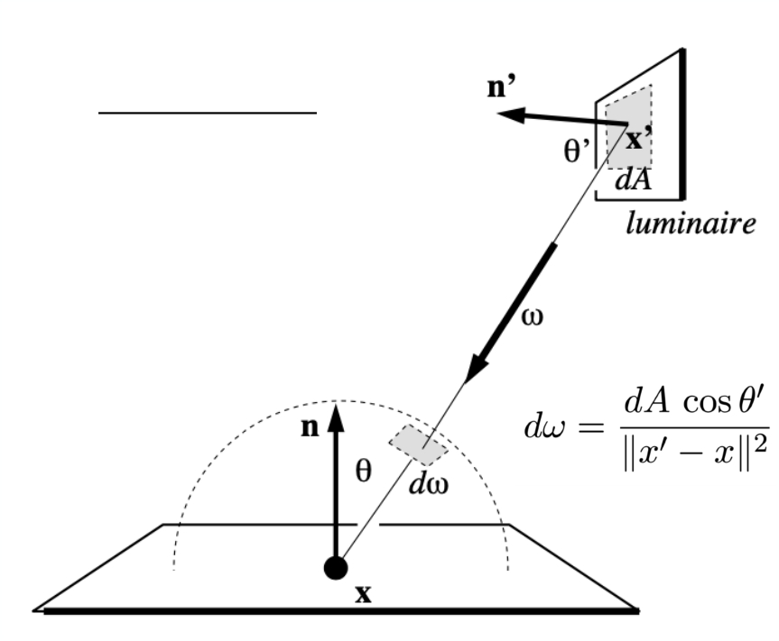
Sampling the Light
Then we can rewrite the rendering equation as
Z
Lo(x, !o) = Li(x, !i)fr(x, !i, !o)cos ✓ d!i
Z
⌦+
=
Li(x, !i)fr (x, !i, !o) cos ✓ cos ✓0 kx0 xk2
dA
A
Now an integration on the light! Monte Carlo integration:
“f(x)”: everything inside Pdf: 1 / A
GAMES101 41 Lingqi Yan, UC Santa Barbara

Slide 42
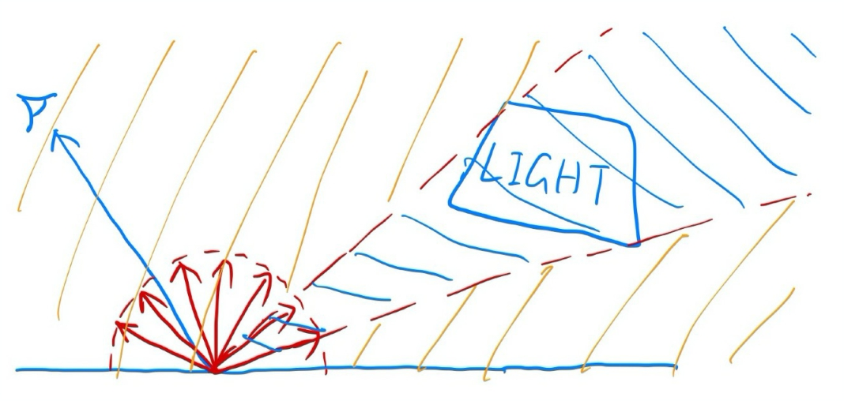
Sampling the Light
Previously, we assume the light is “accidentally” shot by uniform hemisphere sampling
Now we consider the radiance coming from two parts:
1. light source (direct, no need to have RR)
2. other reflectors (indirect, RR)
GAMES101 42 Lingqi Yan, UC Santa Barbara

Slide 43
Sampling the Light
shade(p, wo)
# Contribution from the light source.
Uniformly sample the light at x’ (pdf_light = 1 / A)
L_dir = L_i * f_r * cos θ * cos θ’ / |x’ - p|^2 / pdf_light
# Contribution from other reflectors.
L_indir = 0.0
Test Russian Roulette with probability P_RR
Uniformly sample the hemisphere toward wi (pdf_hemi = 1 / 2pi) Trace a ray r(p, wi)
If ray r hit a non-emitting object at q
L_indir = shade(q, -wi) * f_r * cos θ / pdf_hemi / P_RR
Return L_dir + L_indir
GAMES101 43 Lingqi Yan, UC Santa Barbara

Slide 44
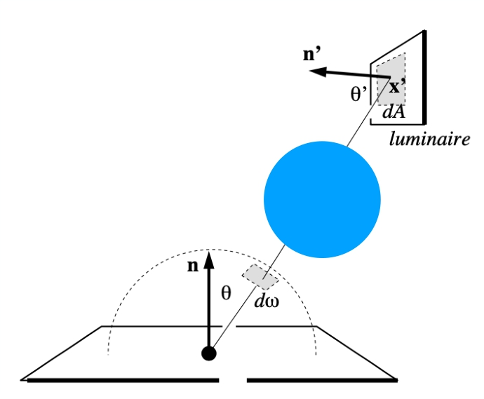
Sampling the Light
One final thing: how do we know if the sample on the light is not blocked or not?
# Contribution from the light source. L_dir = 0.0
Uniformly sample the light at x’ (pdf_light = 1 / A) Shoot a ray from p to x’
If the ray is not blocked in the middle
L_dir = …
Now path tracing is finally done!
p
GAMES101 44 Lingqi Yan, UC Santa Barbara

Slide 45
Some Side Notes
• Path tracing (PT) is indeed difficult
- Consider it the most challenging in undergrad CS
- Why: physics, probability, calculus, coding
- Learning PT will help you understand deeper in these
• Is it still “Introductory”?
- Not really, but it’s “modern" :)
- And so learning it will be rewarding also because …
GAMES101 45 Lingqi Yan, UC Santa Barbara

Slide 46
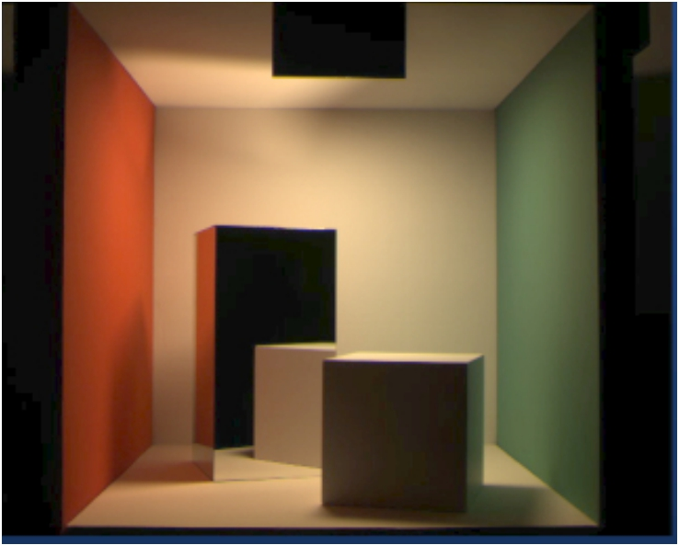
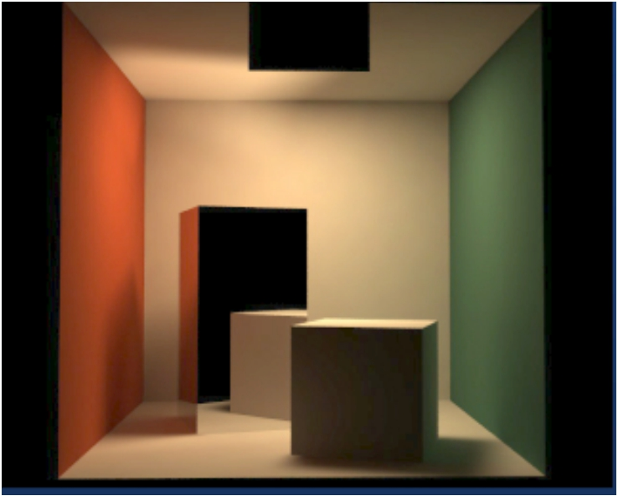
Is Path Tracing Correct?
Yes, almost 100% correct, a.k.a. PHOTO-REALISTIC
Photo
Path traced:
global illumination
The Cornell box — http://www.graphics.cornell.edu/online/box/compare.html
GAMES101 46 Lingqi Yan, UC Santa Barbara

Slide 47
Ray tracing: Previous vs. Modern Concepts
• Previous
- Ray tracing == Whitted-style ray tracing
• Modern (my own definition)
- The general solution of light transport, including - (Unidirectional & bidirectional) path tracing
- Photon mapping
- Metropolis light transport - VCM / UPBP…
GAMES101 47 Lingqi Yan, UC Santa Barbara

Slide 48
Things we haven’t covered / won’t cover
• Uniformly sampling the hemisphere
- How? And in general, how to sample any function?
(sampling)
• Monte Carlo integration allows arbitrary pdfs
- What's the best choice? (importance sampling)
• Do random numbers matter?
- Yes! (low discrepancy sequences)
GAMES101 48 Lingqi Yan, UC Santa Barbara

Slide 49
Things we haven’t covered / won’t cover
• I can sample the hemisphere and the light
- Can I combine them? Yes! (multiple imp. sampling)
• The radiance of a pixel is the average of radiance on all
paths passing through it
- Why? (pixel reconstruction filter)
• Is the radiance of a pixel the color of a pixel?
- No. (gamma correction, curves, color space)
• Asking again, is path tracing still “Introductory”? - This time, yes. Fear the science, my friends.
GAMES101 49 Lingqi Yan, UC Santa Barbara

Slide 50
Thank you!
(And thank Prof. Ravi Ramamoorthi and Prof. Ren Ng for many of the slides!)

